Slide 1

21AIE114
Principles of measurements and sensors

Slide 2
Topic - TLW (Detecting the temperature, light and water using sensors ).
BATCH: E4

Slide 3
tEam members:
M RAMYA SREE (BL.EN.U4AIE21072)
METTU SIDDHARTHA(BL.EN.U4AIE21080)
POLI VAMSI VARDHAN REDDY(BL.EN.U4AIE21101)

Slide 4
CONTENTS
INTRODUCTION
COMPONENTS
DESCRIPTION
CIRCUIT
SIMULATION
CODE
OUTPUT
APPLICATIONS

Slide 5
INTRODUCTION
Farming is an important part of the cycle of life. Our project goal is to help farmers for doing irrigation using sensors like temperature , IR , photo resistor, and Ultrasonic sensors . Through the help of IR sensor the soil moisture can be detected, and through temperature sensor farmer can get to know about the temperature so that the crops which are suitable for those climatic conditions he can cultivated those crops and also if the soil is dry water pumping starts and if soil is wet then water stops pumping. Water level will be detected by using the ultra sonic sensor and photo resistor is connected to a light source so if the climate is sunny the light stops glowing and if it’s dark then the light starts glowing. Our project helps the farmer to save his money and cultivate the crops that are suitable for the climate conditions.

Slide 6
Required components
Arduino UNO R3
Bread Boards
Temperature sensor
Ultra sonic sensor
IR sensor
Photo resistive sensor
Relay SPDT
NPN Transistor
LED’s
NPN Transistor
Resistors
Jumper wires
9V Battery
DC Motor
16X2 LCD Display

Slide 7
Arduino UNO R3
The Arduino Uno R3 pin diagram is shown below. It comprises 14-digit I/O pins. From these pins, 6-pins can be utilized like PWM outputs. This board includes 14 digital input/output pins, Analog inputs-6, a USB connection, quartz crystal-16 MHz, a power jack, a USB connection, resonator-16Mhz, a power jack, an ICSP header an RST button.
The power supply of the Arduino can be done with the help of an exterior power supply otherwise USB connection. The exterior power supply (6 to 20 volts) mainly includes a battery or an AC to DC adapter.
. The connection of an adapter can be done by plugging a center-positive plug (2.1mm) into the power jack on the board. The battery terminals can be placed in the pins of Vin as well as GND. The power pins of an Arduino board include the following. Vin: The input voltage or Vin to the Arduino while it is using an exterior power supply opposite to volts from the connection of USB or else RPS (regulated power supply).

Slide 8
Ultra sonic sensor
Ultrasonic Sensor HC-SR04 is a sensor that can measure distance.
It emits an ultrasound at 40,000 Hz (40kHz) which travels through the air and if there is an object or obstacle on its path it will bounce back to the module.
Considering the travel time and the speed of the sound you can calculate the distance.
The configuration pin of HC-SR04 is VCC (1), TRIG (2), ECHO (3), and GND (4).
The supply voltage of VCC is +5V and you can attach TRIG and ECHO pin to any Digital I/O in your Arduino Board.

Slide 9
Temperature sensor
The Temperature Sensor LM35 series are precision integrated-circuit temperature devices with an output voltage linearly proportional to the Centigrade temperature.
The LM35 device has an advantage over linear temperature sensors calibrated in Kelvin,
In the LM35 user is not required to subtract a large constant voltage from the output to obtain convenient Centigrade scaling.

Slide 10
Infrared sensor(IR sensor)
An infrared sensor is an electronic device, that emits in order to sense some aspects of the surroundings.
An IR sensor can measure the heat of an object.
The IR sensor has a 3-pin connector. The connections are as follows:
1. VCC is the power supply pin for the IR sensor which we connect to the 5V pin on the Arduino.
2. OUT pin is a 5V TTL logic output.
3. GND Should be connected to the ground of the Arduino.

Slide 11
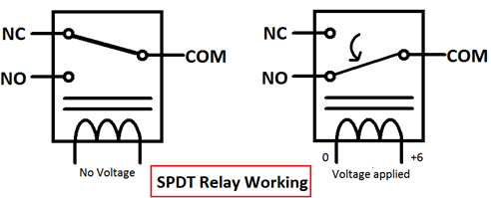
RELAY SPDT
Relay is an electromagnetic switch, which is controlled by small current, and used to switch ON and OFF relatively much larger current.
It means by applying small current we can switch ON the relay which allows much larger current to flow.
A relay is a good example of controlling the AC (alternate current) devices, using a much smaller DC current.
Single Pole Double Throw (SPDT) Relay is commonly used Relay , it has five terminals as below:

Slide 12
16x2 Liquid Crystal Display
Why it is called 16x2 ?
Because you can write 16 characters or numbers in column wise and 2 in row wise. This display have total of 16 pins. Here I only use 12 pins. Here we use the pins except D0, D1, D2, D3. Because here I interface the LCD in 4 bit mode.
The use of pins listed below
GND(VSS)
VCC
Contrast (VEE)
RS
RW
EN (E)
D0-D7 (DB0-DB7)
A-Backlight(+) This is the anode pin of the backlight of the display
K-Backlight(-) This is the cathode pin of the backlight of the display

Slide 13
PHOTO RESISITOR:
A photoresistor (also known as a Photocell, or light-dependent resistor, LDR, or photo-conductive cell) is a passive component that decreases resistance with respect to receiving luminosity (light) on the component's sensitive surface. The resistance of a photoresistor decreases with increase in incident light intensity; in other words, it exhibits photoconductivity. A photoresistor can be applied in light-sensitive detector circuits and light-activated and dark-activated switching circuits acting as a resistance semiconductor.

Slide 14
DC MOTOR:
A Direct Current motor is the most common type of motor.
DC motors normally have just two leads, one positive and one negative.
If you connect these two leads directly to a battery, the motor will rotate.
If you switch the leads, the motor will rotate in the opposite direction.

Slide 15
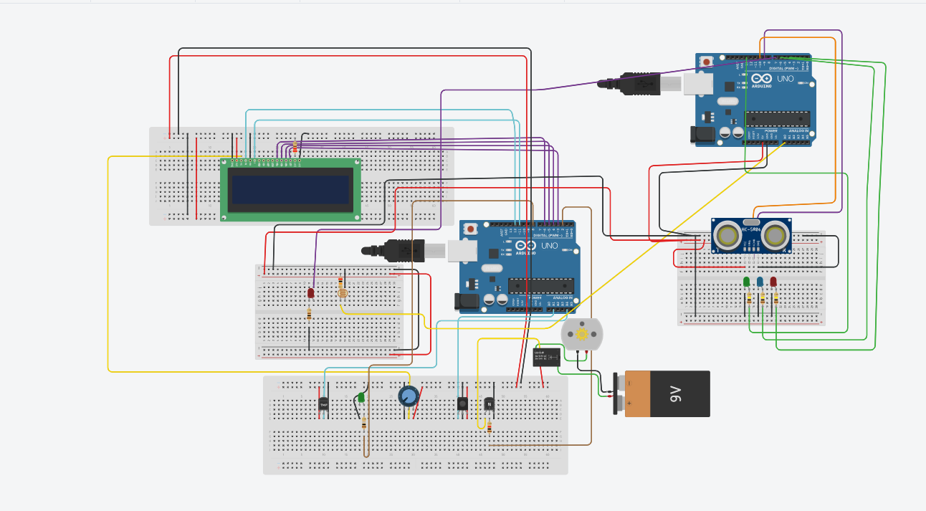
CIRCUIT

Slide 16
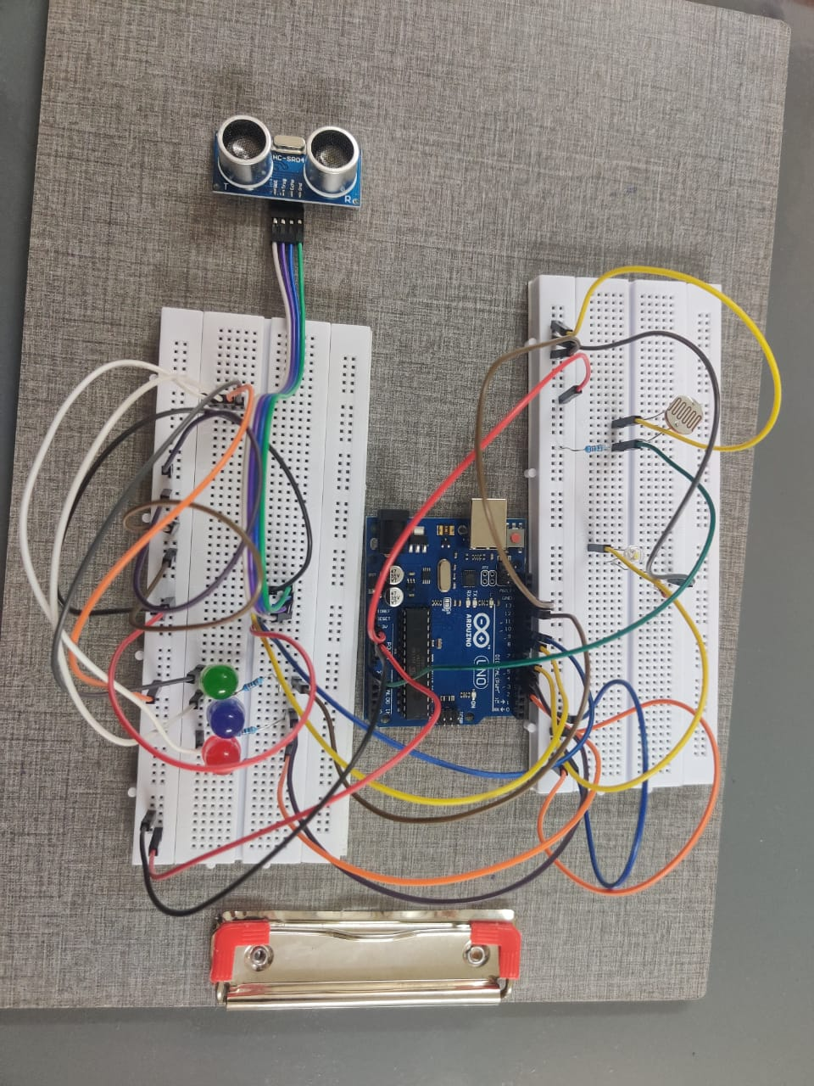
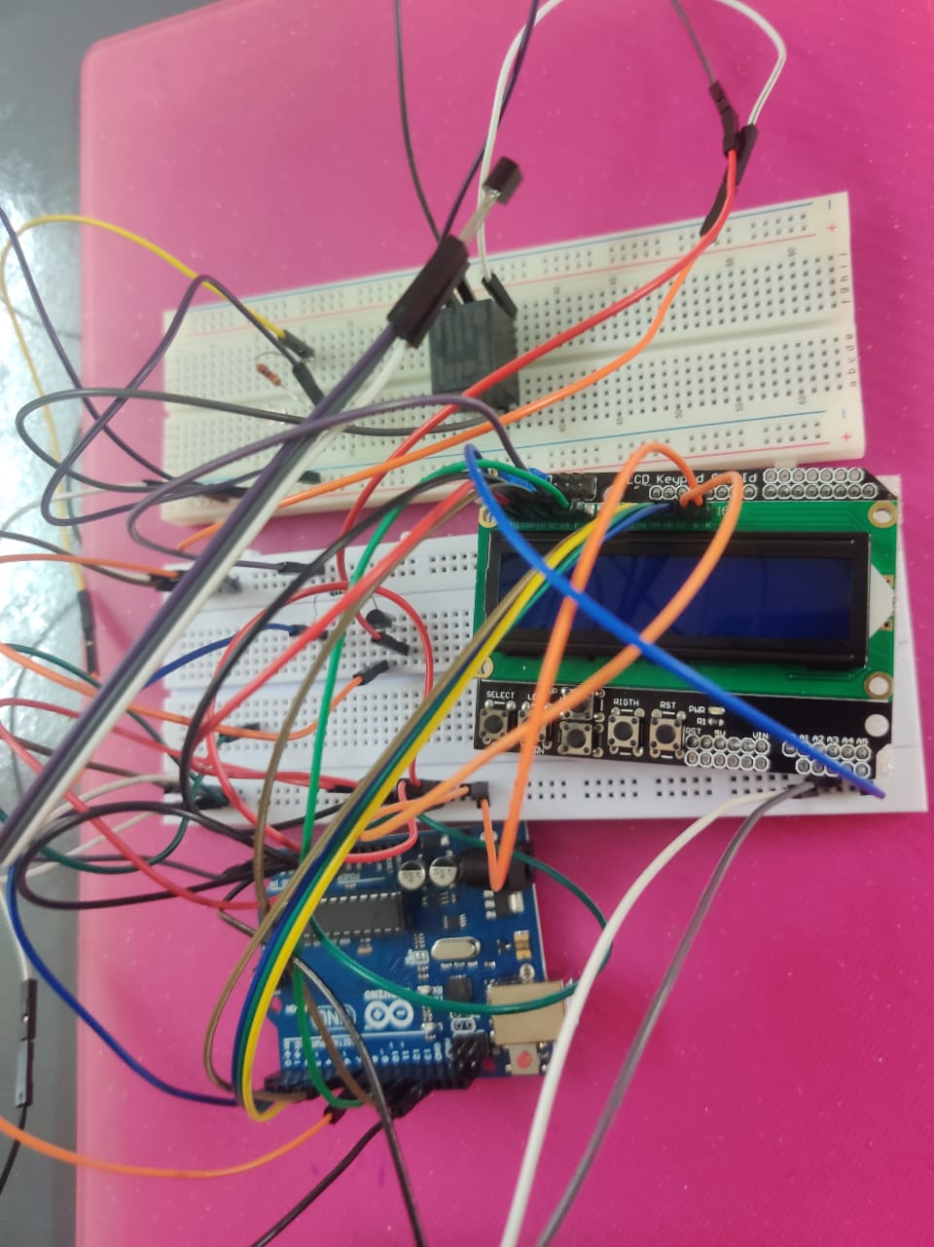

Slide 17
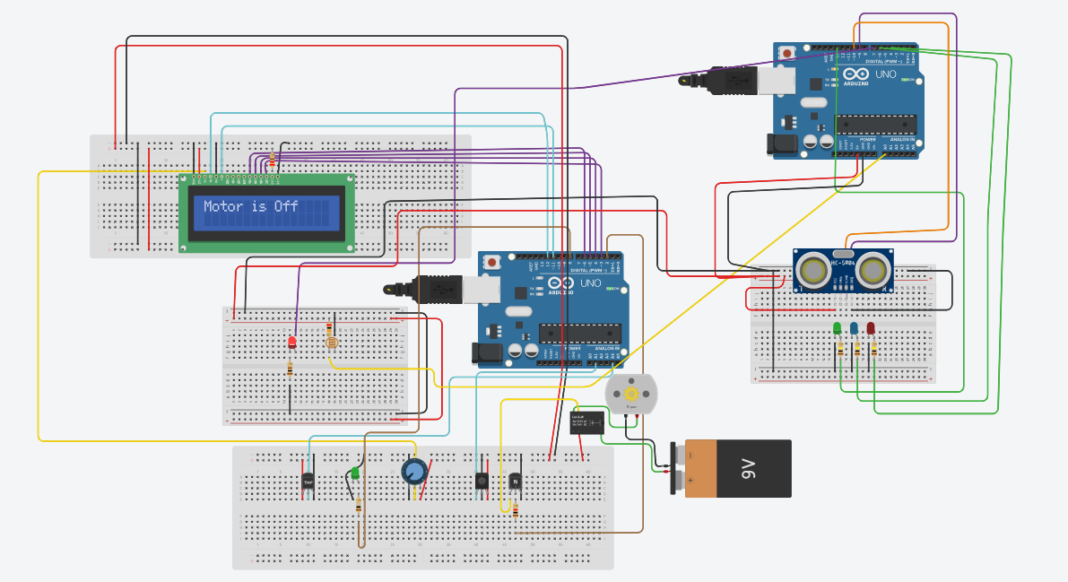
OUTPUT:

Slide 18
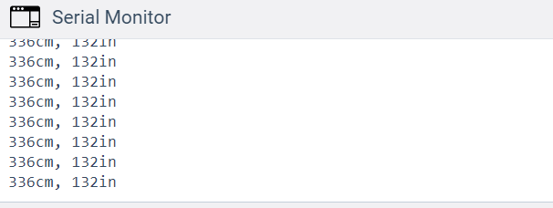
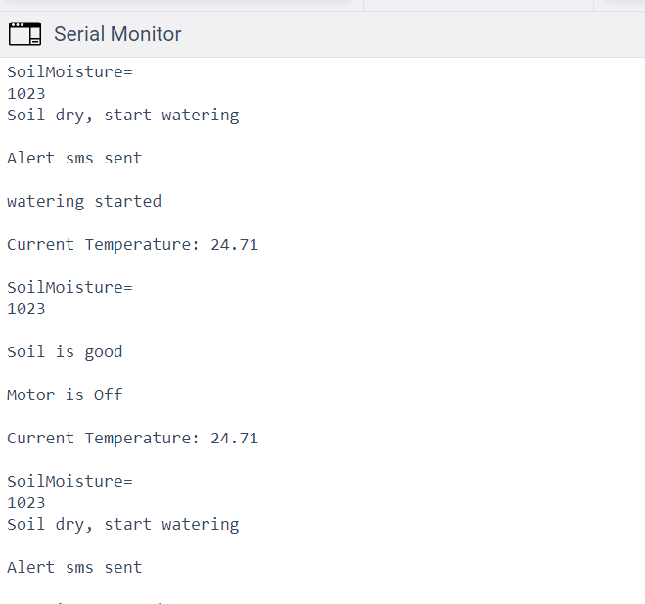
Serial monitor:
Ultra sonic sensor distance measurement:
Current Temperature and soil moisture:

Slide 19
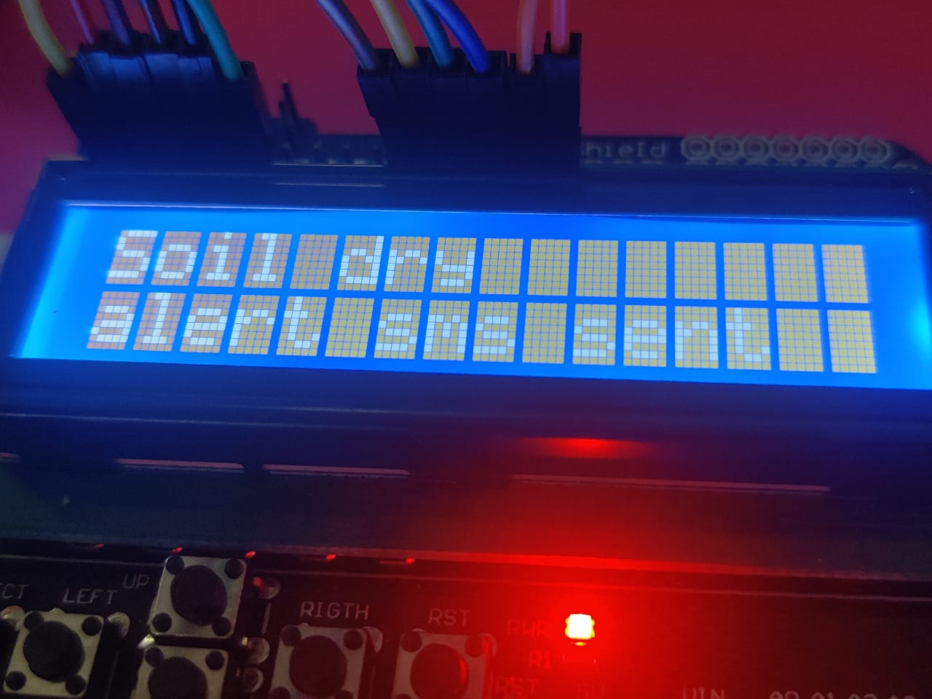
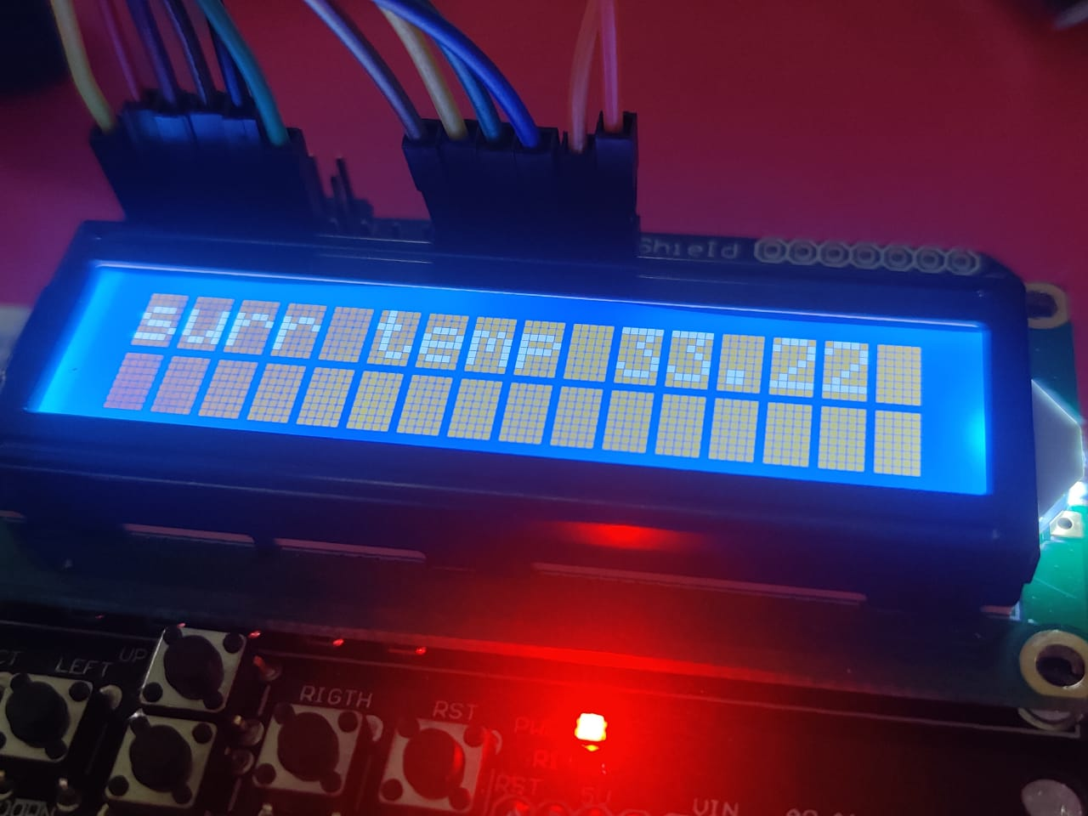
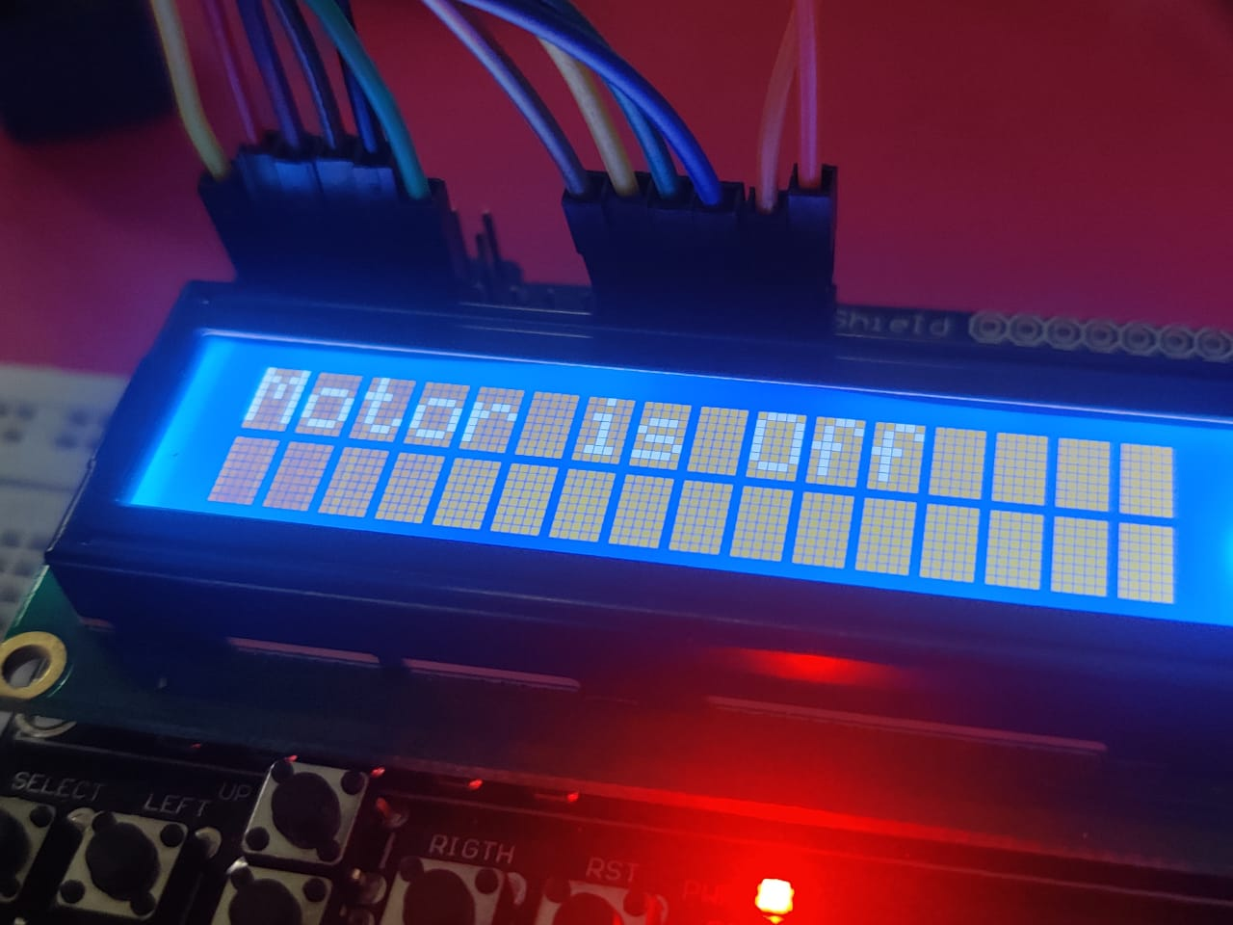
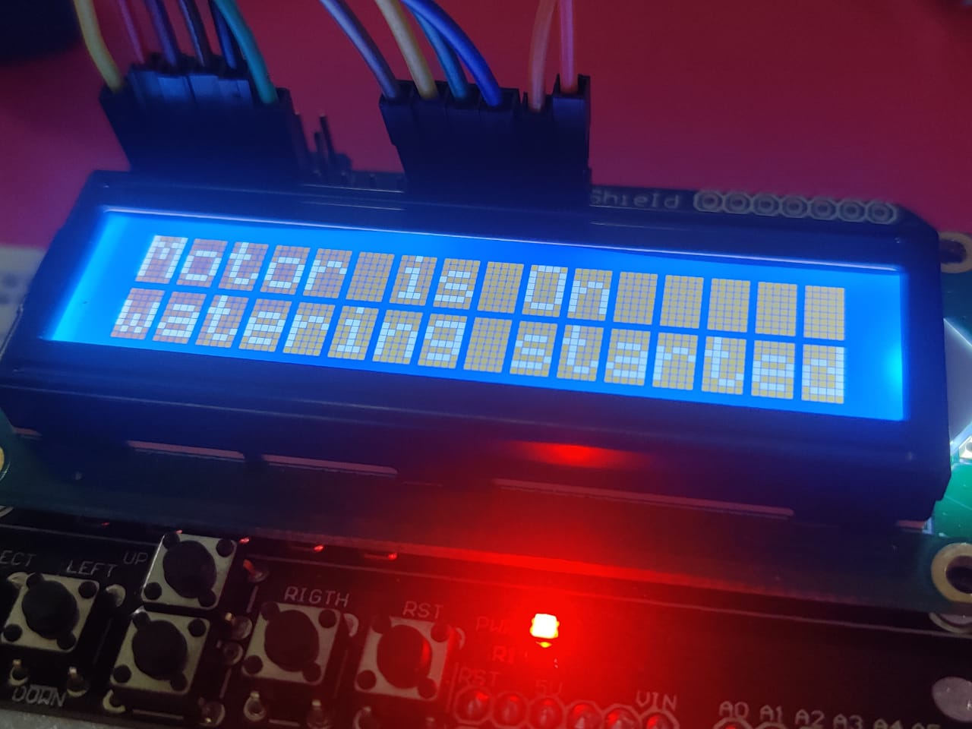
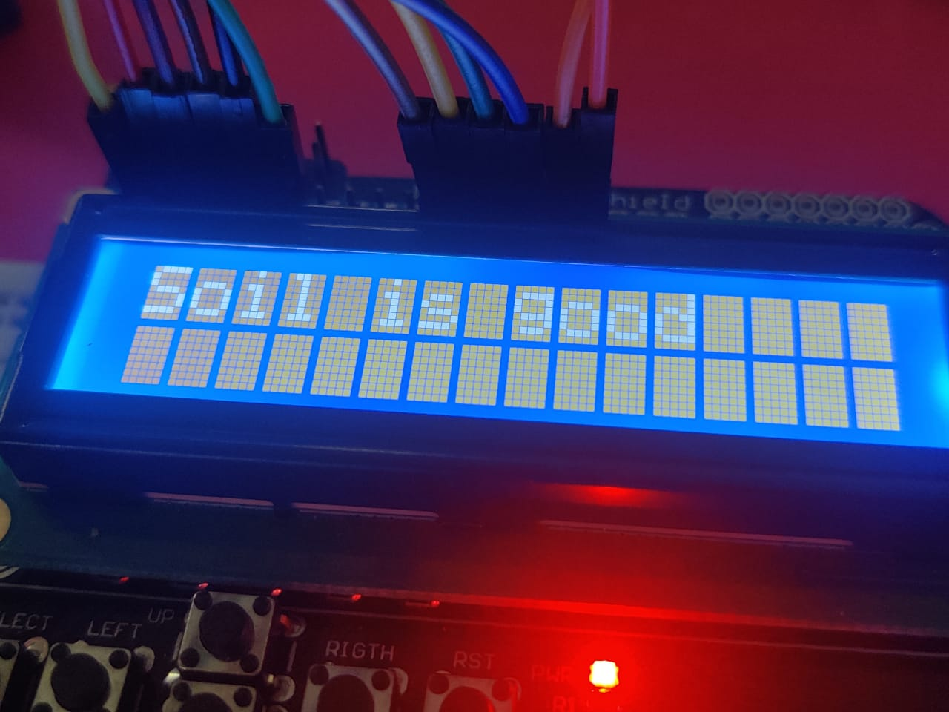
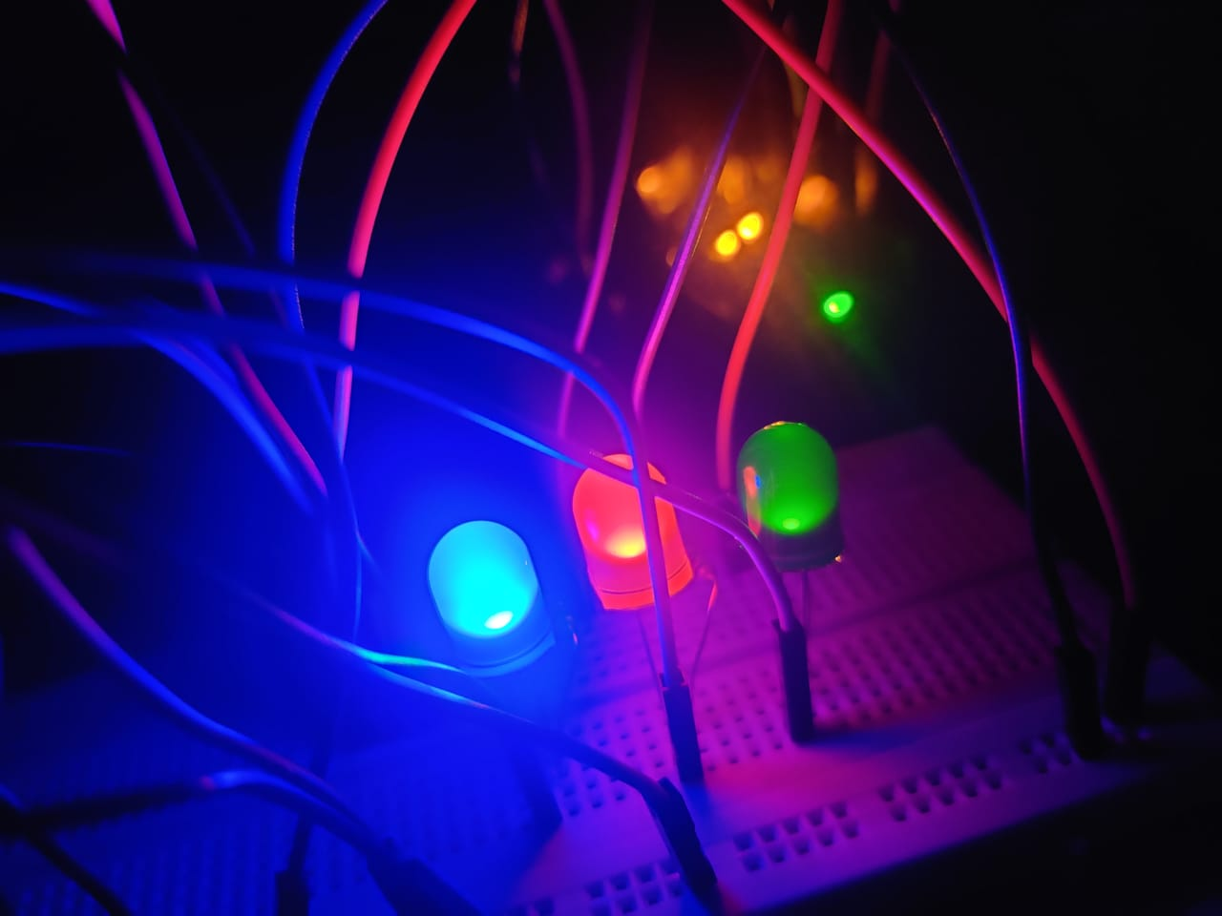
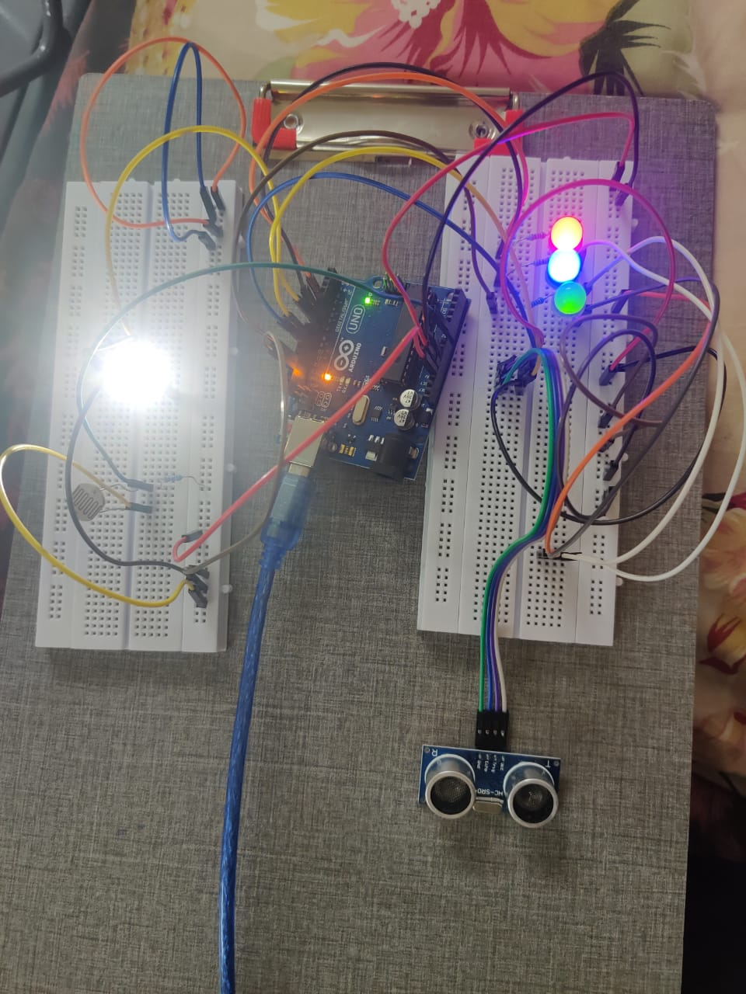
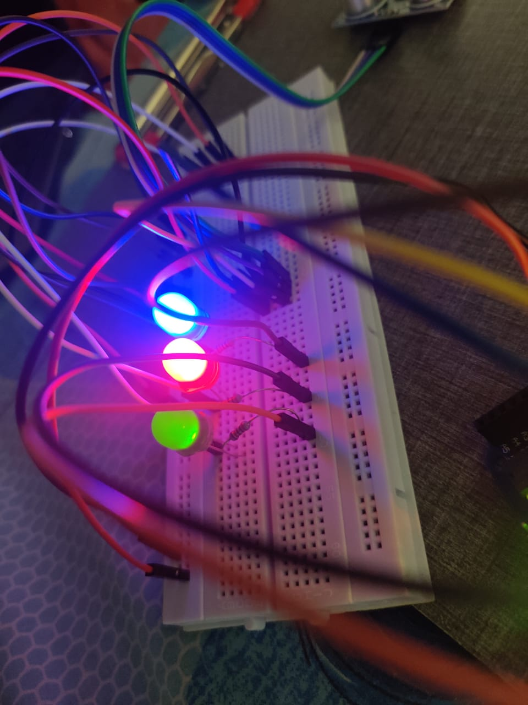
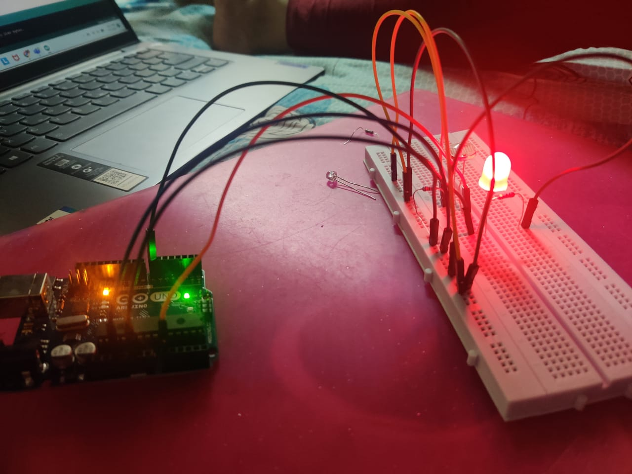

Slide 20
IN SERIAL MONITOR:
SoilMoisture=
291
Soil dry, start watering
Alert sms sent
watering started
Current Temperature: 16.37
SoilMoisture=
4
Soil is good
Motor is Off
Current Temperature: 42.25

Slide 21
IN SERIAL MONITOR:
Ultra sonic sensor:
109cm, 42in
109cm, 42in
110cm, 43in
110cm, 43in
109cm, 42in
110cm, 43in
110cm, 43in
109cm, 42in

Slide 22
APPLICATIONS
Agriculture sector
Chemical plants
Liquid storage systems
Factories
To control pump activation systems.

Slide 23
Thank you

